Slide 1
TEAM 0K
COGNIZANT HACKATHON BUSINESS CASE

Slide 2

TABLE OF CONTENTS
1. Problem Statement and Analysis
2. Exploratory Data Analysis
Data and Feature Visualizations
Arguments and Hypothesis
3. Machine Learning Methodology
4. Business Solution Proposal

Slide 3


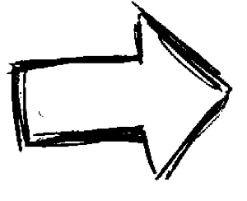
THE PROBLEM
145245 Seconds = 1.68 Days
$31169.74
Notes:
Average loss per day: 31169.74

Slide 4
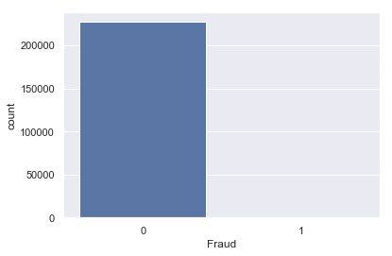
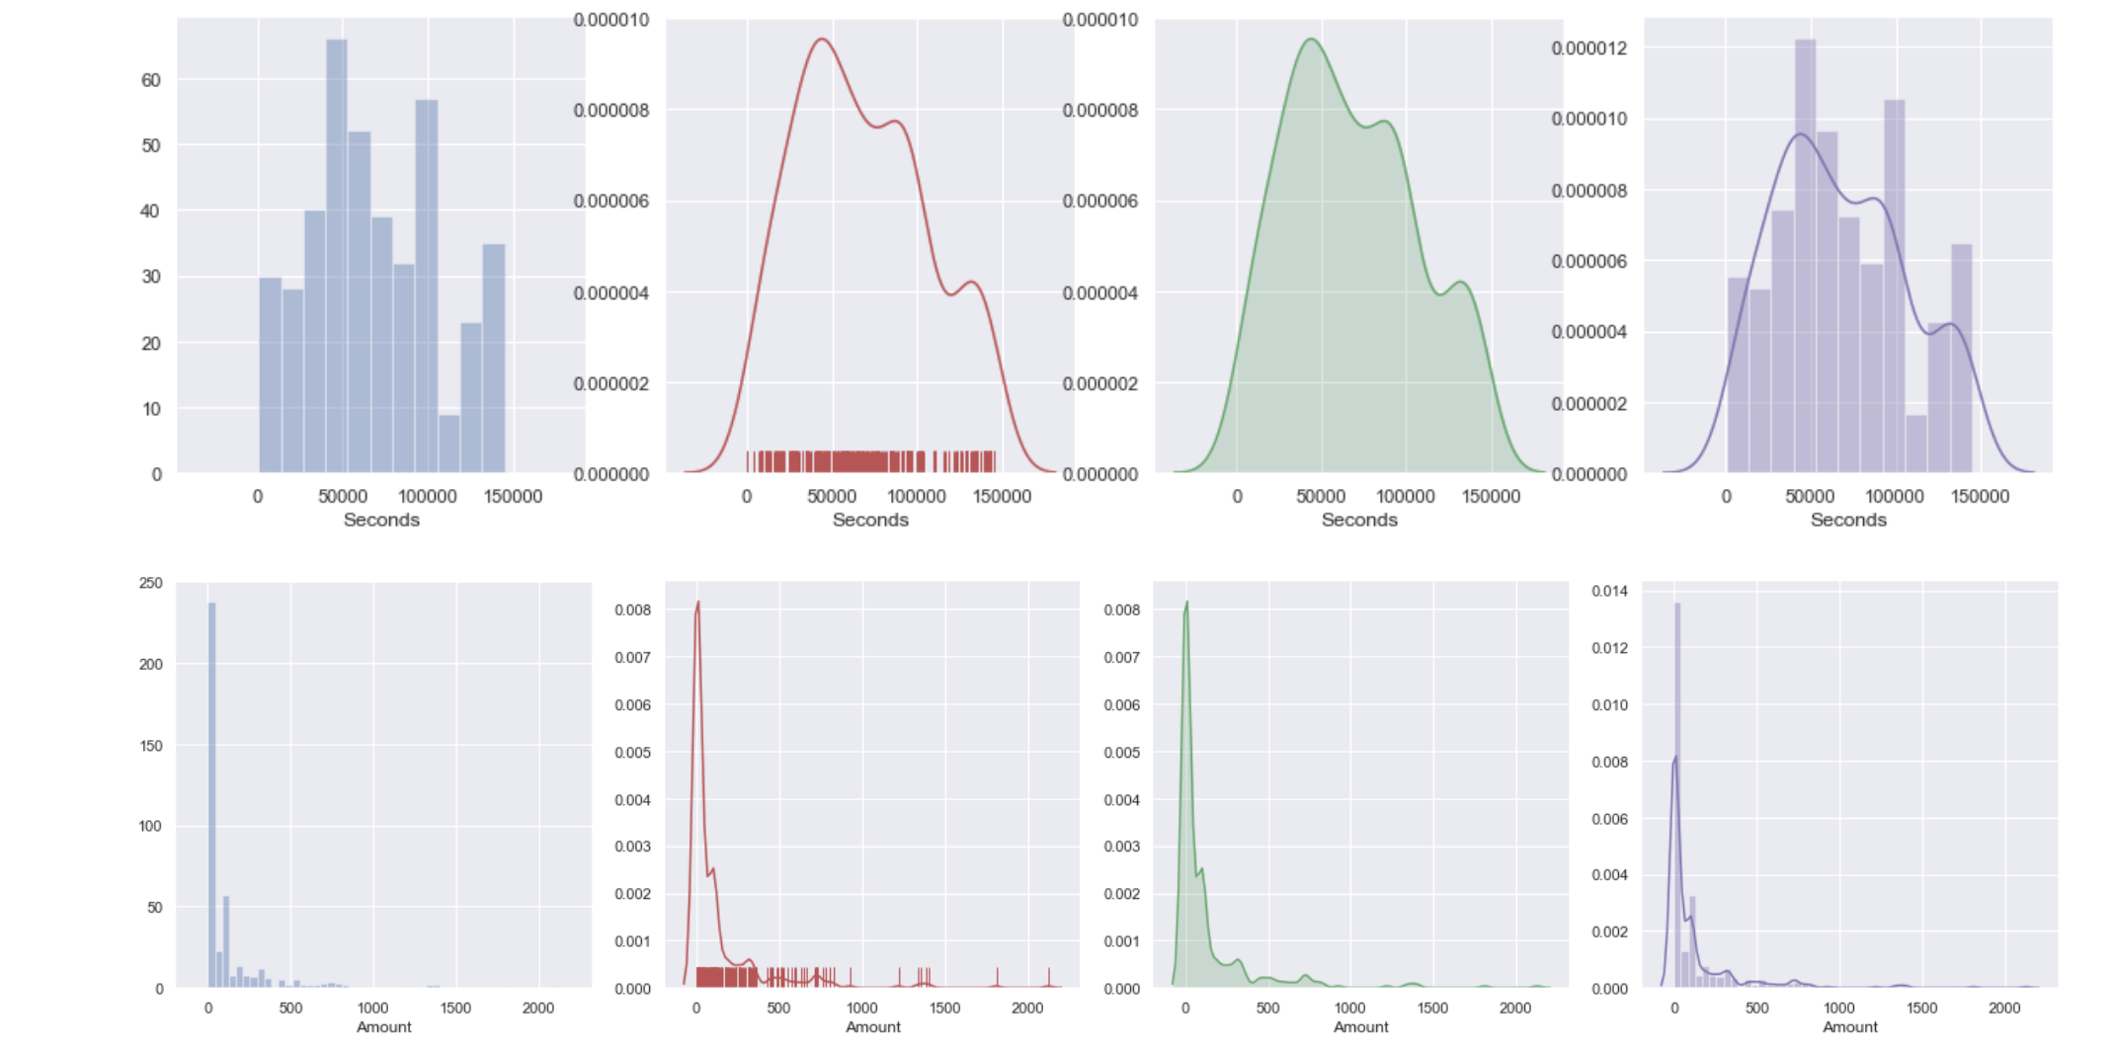
VISUALIZATIONS
There are 227351 non-fraudulent transactions and only 411 fraudulent transactions.
Percentage of fraudulent transactions only make up 0.18% of the entire dataset.
From the Kernel Density Estimate and Histograms, the dataset seems to have a degree of imbalance which will be explored later.

Slide 5
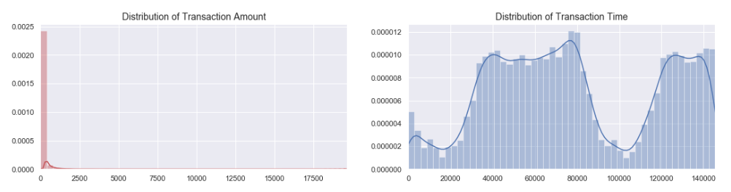
VISUALIZATIONS
Kurtosis: Measure of a probability distribution’s “tailedness” and the sharpness of the peaks.
Skewness: Asymmetry of probability distribution
Skewness and Kurtosis violates the assumption of multivariate normality under regression models. This could distort the training of linear or logistic regression models.
Skewness: 14.07
Kurtosis: 514.37
Skewness: 0.12
Kurtosis: -1.11
Notes:
SKEWNESS AND KURTOSIS VALUES NEEDED

Slide 6
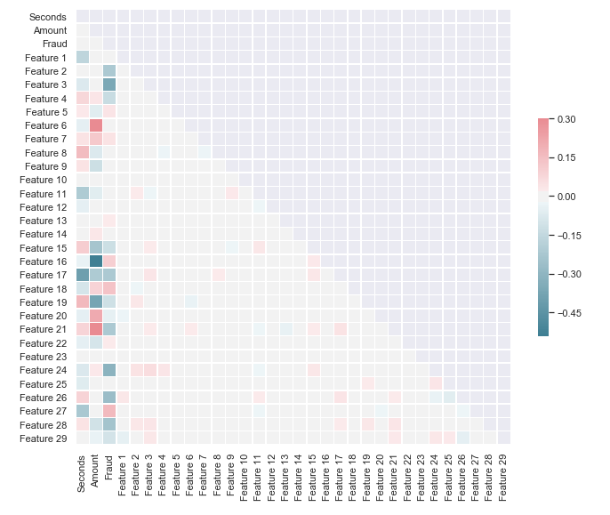
VISUALIZATIONS: HEATMAP CORRELATIONS
From the heatmap, it can be observed that there are few strong correlations among the variables.
This could be the result of the severely imbalanced dataset.
The correlations will be explored later on after balancing out the dataset.
Notes:
HEATMAP CORRELATION AND BOXPLOTS
Correlations among variables are not very strong, which indicates a need to retain all features or else risk information loss.

Slide 7
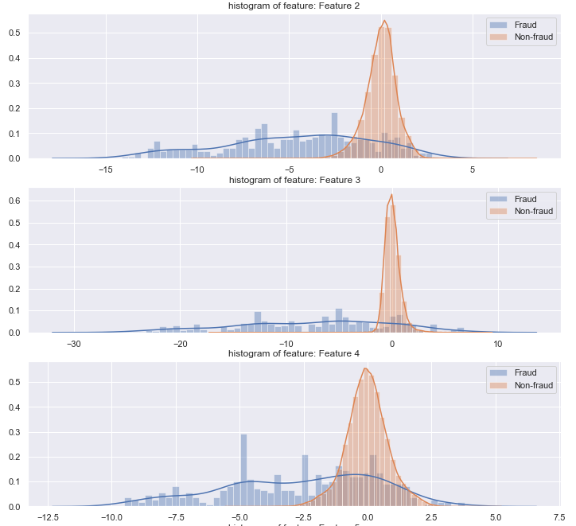
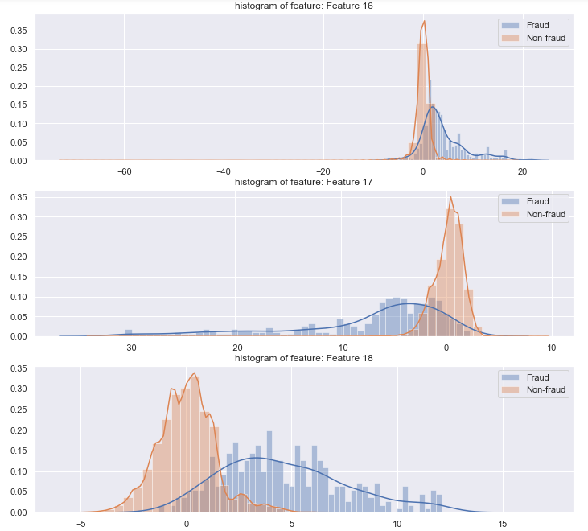
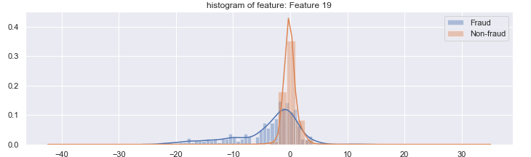
FEATURE VISUALISATION
Notes:
FEATURE ENGINEERING

Slide 8
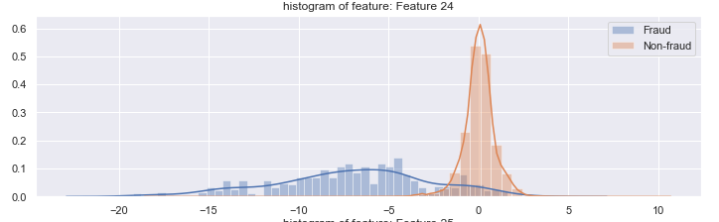
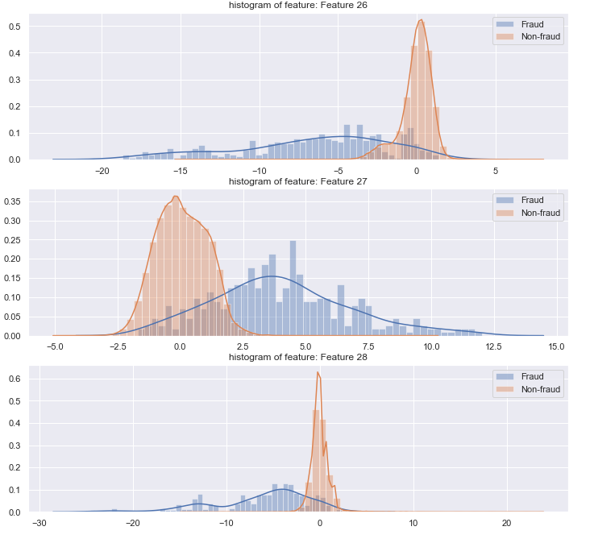
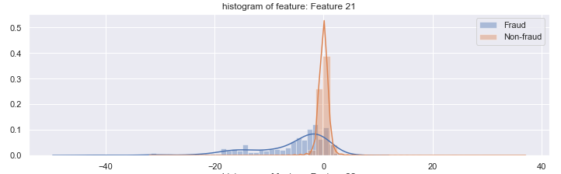
FEATURE VISUALISATION
Notes:
RANDOM UNDERSAMPLING

Slide 9
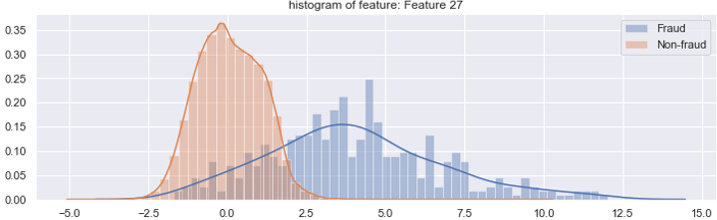
FEATURE ENGINEERING
4.0
For example, in Feature 27
Most of the non-fraud samples have a Feature 27 value of less than 4.
Hence, we classify those with Feature 27 values of higher than 4 to be fraudulent and the others as non-fraudulent.
This is to signal to the machine learning model of this information, hence enhancing information gain.
Notes:
DRAW LINE ACROSS GRAPH TO EXPLAIN
FEATURE ENGINEERING HELPS TO SEND SIGNAL TO NON-TREE BASED CLASSIFIERS WHICH DO NOT USE DECISION TREES

Slide 10
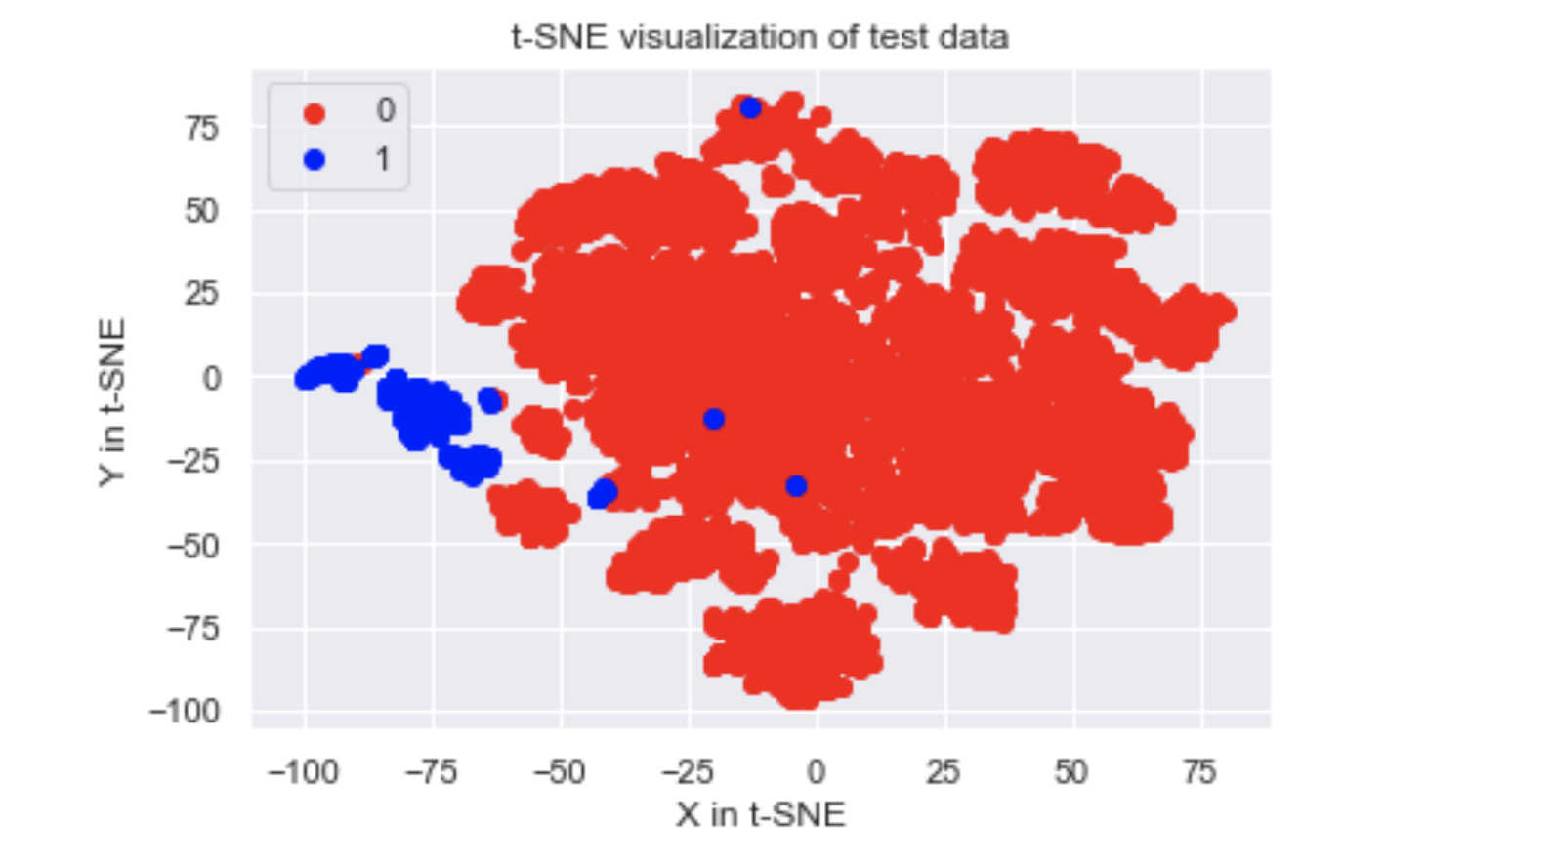
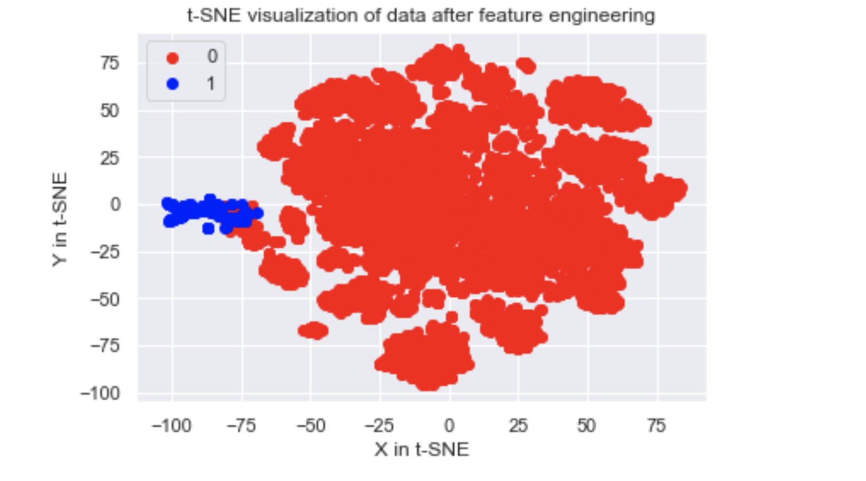
FEATURE ENGINEERING RESULTS
Comparing the T-sne plots (left: non-feature engineered, right: feature engineered),
We can observe that after feature engineering the fraudulent transaction are better clustered and this signifies that it is easier for a linear classifier to segment the fraudulent transactions
Notes:
This is before and after

Slide 11
ARGUMENTS AND CONCLUSIONS
Hypothesis:
Due to the extremely imbalanced classes, it is important for us to balance the classes so that our classification model is able to produce useful outputs
Different metrics
Subsampling of results
Assigning of weightage to different classes
Reframe as anomaly detection
Notes:
Heatmap Correlation

Slide 12
MACHINE LEARNING METHODOLOGY
TEAM 0K

Slide 13
Selection of models
Classifier |  | Precision | Recall | F1-score
Classification based models | Logistic Regression | 0.88 | 0.69 | 0.77
 | Random forest | 0.99 | 0.77 | 0.86
 | Xgboost | 0.93 | 0.79 | 0.85
Anomaly based models | Isolation forest | 0.65 | 0.57 | 0.61
 | Local Outlier Fraction | 0.21 | 0.21 | 0.21
Based on preliminary results the classifiers seem to produce better results as compared to anomaly based models
Focus our efforts on classification based models instead of anomaly based models
This could have been possibly due to the fact that the classification models employed are models with high capacity to learn the numerous factors

Slide 14
Dealing with class imbalances
1. General data preprocessing
Robust scalar
2. Dealing with class imbalances
Choice of metric
Oversampling (SMOTE)
Varying the classes loss weight
Reframe the problem as anomaly detection problem

Slide 15
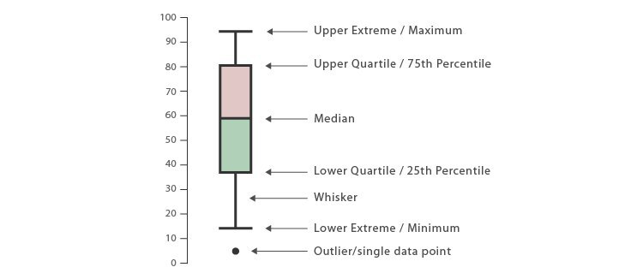
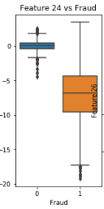
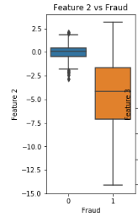
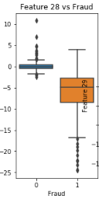
Robust scaling
The box-plots reveal significant amount of outliers in the data, labelled using red circles.
We conclude that we should not remove outliers from the dataset due to uncertainty surrounding the cause of the outliers and the unknown nature of the PCA-transformed features.
Robust scaling allows us to de-emphasise the impact of the outliers instead of completely removing them. It scales the data according to the Inter-Quartile Range instead of Standard Deviation.
Notes:
Boxplots shows outliers. Get a picture to show the correct interpretation of a boxplot.
Scaling
In this case, we believe that we should not remove outliers from the dataset because it is uncertain how these outliers arose. If they were incorrectly processed or invalid, it would make sense to remove them to achieve a more accurate dataset. However, due to the lack of information, we decide to keep them and instead de-emphasise them using robust statistics while not completely removing them. For example, instead of using standard deviation which would be the case of normal data, we use IQR (Interquartile range).
We use Sklearn's RobustScaler for scaling because it is noramlly used to scale features using statistics that are robust to outliers. It removes the median and scales the data according to the IQR which is the range between the 1st and 3rd quartile.
We use reshape(-1,1) to create a column with Numpy figuring out the number of rows from the original sample.

Slide 16
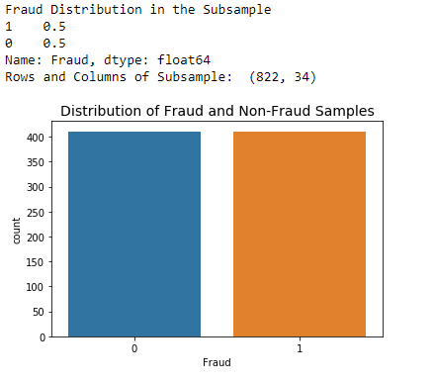
Dealing with class imbalance - Random undersampling
Undersampling
Random Under-sampling involves data removal of the majority labels to achieve a more balanced dataset and reduce the risk of overfitting.
A subsample with equal numbers of fraudulent and non-fraudulent transactions is created with most of the non-fraudulent transactions removed. It has 50/50 ratio with regards to our classes.
The data is shuffled randomly to evaluate the periodic accuracy of our classification models.
The main problem behind undersampling is the potential loss of accuracy in model performance due to the information loss.
Equal Distribution of the Subsample
Notes:
EXPLANATION

Slide 17
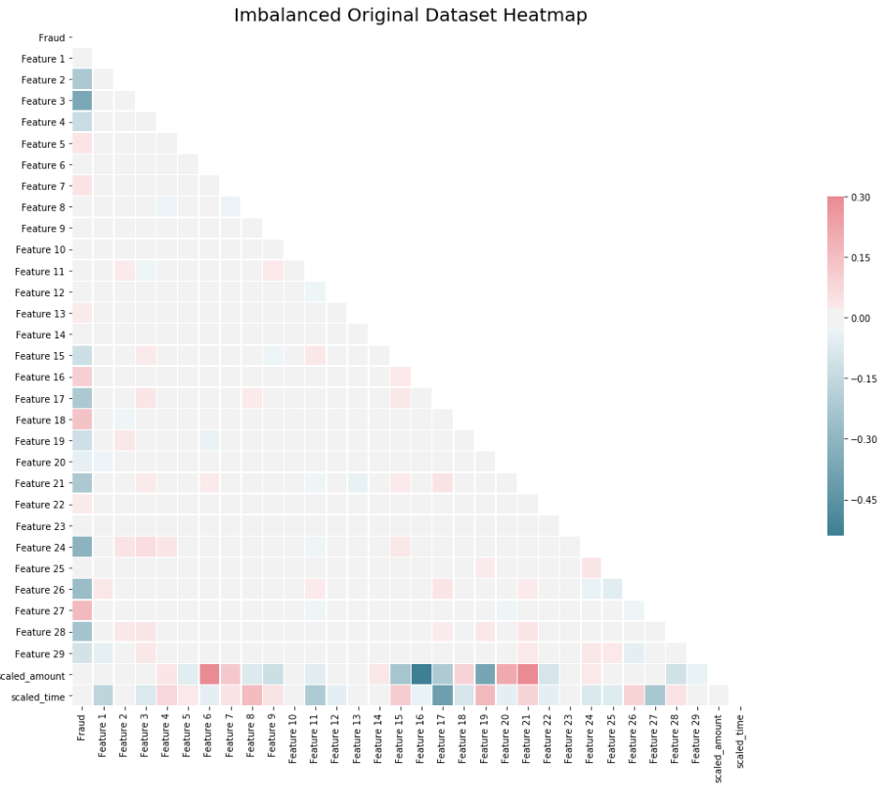
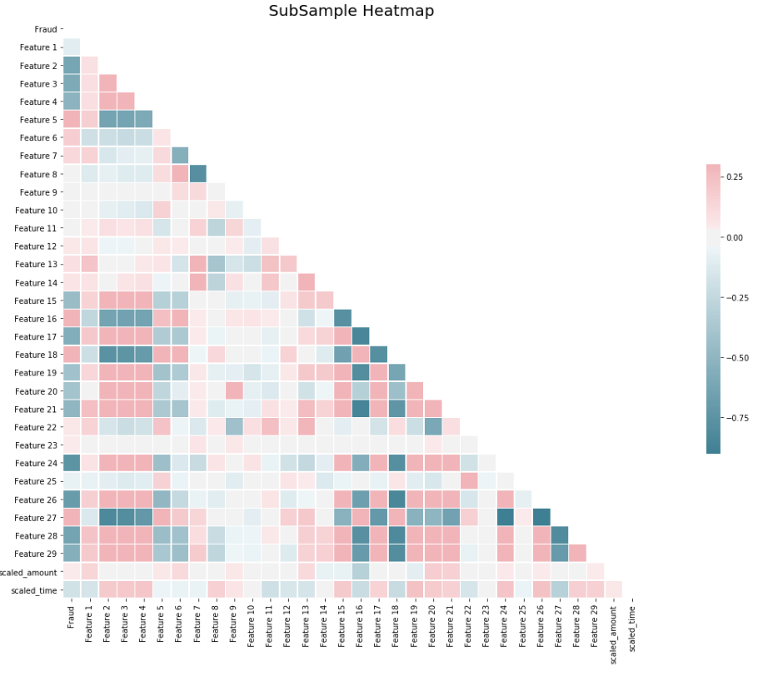
Dealing with class imbalance - Random undersampling
After undersampling, the correlations among variables can be observed to have increased.
Notes:
RESULTS

Slide 18
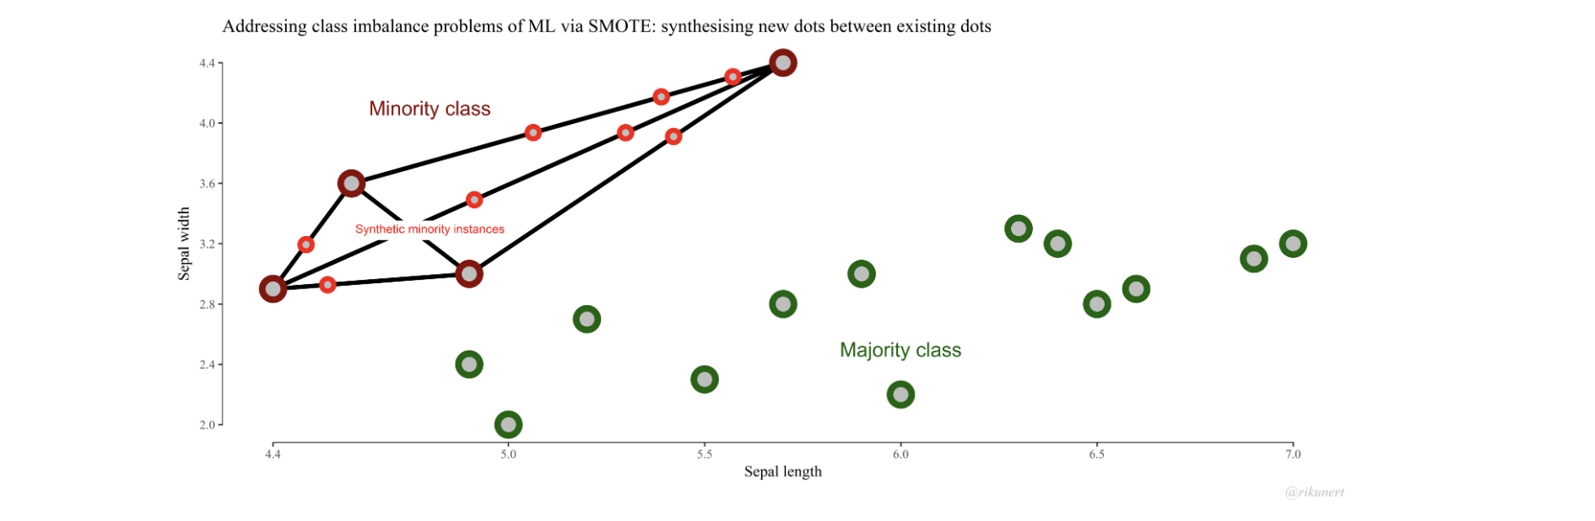
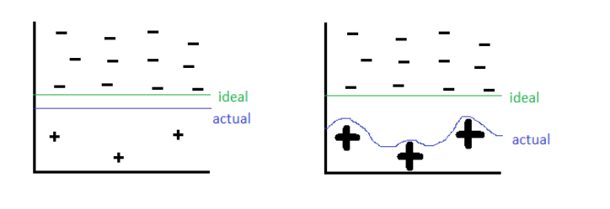
Dealing with class imbalance - Minority oversampling (SMOTE)
SMOTE
For each minority class (Non-fraudulent transaction), it picks a neighbouring point and generates a new point based on the distance between each other.
Generate new data points to deal with imbalanced dataset.
Allows models to better fit and classify the minority samples, resulting in tighter decision boundaries
Avoids information loss caused by undersampling and yet maintain an equal distribution of classes
Generation of Synthetic Points based on Minority’s Nearest Neighbours
Decision Boundaries of Original Dataset
Decision Boundaries of Oversampled Dataset
Notes:
This is before and after

Slide 19
Dealing with class imbalance - SMOTE results
Classifier | No SMOTE dataset |  |  | SMOTE dataset
 | Recall | Precision | F1-score | Recall | Precision | F1-score
Logistic regression | 0.69 | 0.88 | 0.77 | 0.83 | 0.80 | 0.82
Random Forest | 0.77 | 0.99 | 0.86 | 0.84 | 0.93 | 0.88
Xg-boost | 0.79 | 0.93 | 0.85 | 0.85 | 0.82 | 0.84
Results
Through the results we can see by artificially generating more fraud data points, we are able to increase the F1-score for all three classifiers. This signifies the model is better able to capture the fraudulent transactions

Slide 20
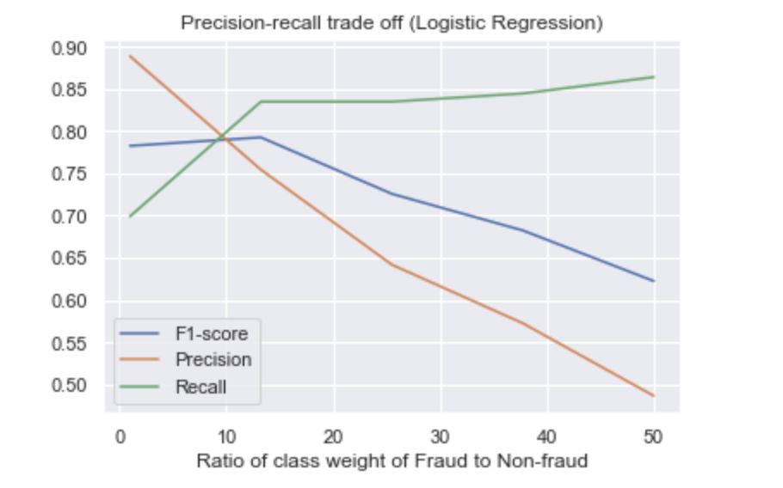
Dealing with class imbalance - adjusting class weights
Adjusting class weights
By adjusting the class-weights of fraudulent transactions, the model will pay more attention to these fraudulent transactions and try to optimize to detect these.
The figure illustrates how with greater emphasis on fraudulent transaction (higher ratio of weights) , the model is able to capture more fradulent transactions (recall)
This graph also illustrates the precision-recall trade off whereby by predicting more fradulent transactions, the accuracy of each prediction will fall.
We will tune the class weight of fraud treating it as a hyper-parameter

Slide 21
PROPER ACCURACY METRICS USED WITH JUSTIFICATIONS
Accuracy metric chosen is F-1 Score, the weighted average of Precision and Recall, as it takes both false positives and false negatives into account.
Precision is the ratio of correctly predicted fraudulent transactions to all predicted fraudulent transactions.
Recall is the ratio of correctly predicted fraudulent transactions to all actual fraudulent transactions.
Accuracy is the ratio of correctly predicted transactions to all transactions. By predicting all fraud cases, we were able to obtain an accuracy of 99.8%. This illustrates why accuracy is not useful as a metric

Slide 22
DECISION OF PARAMETER VALUES EMPLOYED
Randomized search: Try out random combination of hyperparameters used to train the model
Grid search: Try out fixed combinations of hyperparameters
We utilized a randomized search as often it is hard to guess accurately before-hand what features are important and what are the range of scale these values should take
Randomized search also allows us to specify our compute duration more clearly

Slide 23
ASSUMPTIONS USED FOR FORMULATION
The data is correctly inputted and outliers are not a result of incorrect input of data.
Outliers have an impact on the dependent variables (E.g. Fraud).
The data generated using SMOTE does not distort the underlying distribution of the data.
All features are contributing evenly in the decision and prediction model.
All attributes are statistically independent.

Slide 24
BUSINESS SOLUTION PROPOSAL
TEAM 0K

Slide 25


RECOMMENDATIONS FOR APPLICATION OF MODEL
Classifications of transactions Detecting and flagging potential fraudulent transactions, setting threshold score for which transaction the model considers to be a fraud
Selection of Features Choosing important features to input - such as distance between previous and current transactions, transaction medium

Slide 26
MACHINE LEARNING MODEL VS MANUAL EXPERT RULES MODEL
MACHINE LEARNING MODEL | EXPERT RULES MODEL
ACCURACY INCREASES OVER TIME | ACCURACY BASED OFF HUMAN INTERPRETATION AND SUPERVISION
MODEL IMPROVES BY ITSELF | REQUIRES TIME, RESEARCH AND STATISTICAL EXPERTISE TO TUNE
MODEL IS MORE SCALABLE AS IT CAN BE TRAINED ON THE DATASET WHICH WILL FACTOR IN DIFFERENCES IN VARIABLES | MODEL REQUIRES MANUAL FINE TUNING AND MAY NOT ALWAYS FIND THE OPTIMAL RESULTS DESIRED

Slide 27



APPLICATIONS OF INSIGHT TO REAL LIFE BUSINESS CONTEXT
Automate response/investigation of high risk transaction
Analyze different periods of fraud - high alert system based on time and location
Main problem of lag time and speed - tackling the response to fraud

Slide 28
APPLICATIONS OF INSIGHT TO REAL LIFE BUSINESS CONTEXT
Consider implementing the machine learning model together with automated response system to provide immediate investigation and responses on suspicious transactions
Consider various layers of threshold based on potential risks of transactions which provides different alert layers.
Consider the implementation of alert systems to credit card users to allow quick notifications for immediate actions

Slide 29

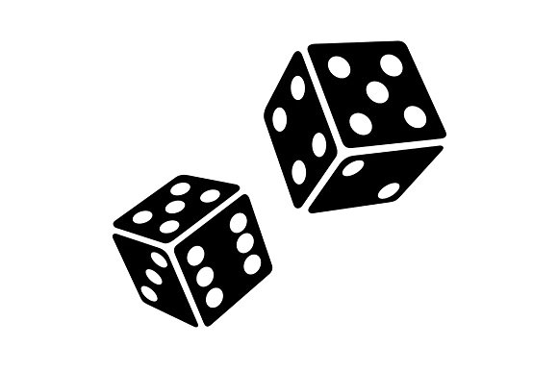
IMPORTANT CONSIDERATIONS
No ensemble should be used since there will be an increase lag time. A simpler model will result in more efficient analysis which will quicken the response time against a fraudulent transaction.
The probability of a fraudulent transaction can be classified into different layers where each demand a particular response. This can be done through immediate calls, messages and notifications through credit card (or bank) smartphone applications.

Slide 30
THE END

